Slide 1
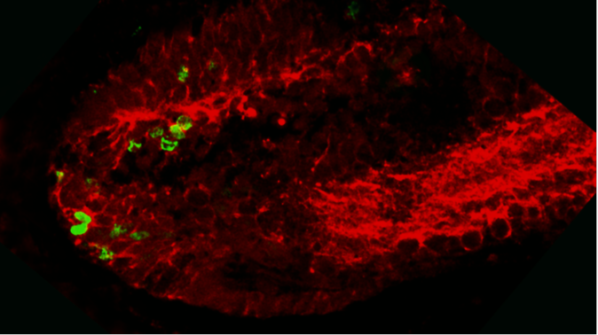
Figure 7
A
ONL
INL
GCL
CMZ
BrdU/HuC
CE
B
ONL
INL
GCL
BrdU/beta III tub
CE
CMZ

